Slide 1
Making Faces: Conditional generation of faces using GANs via Keras+Tensorflow
Sophie Searcy

Slide 2
Who am I?

Slide 3
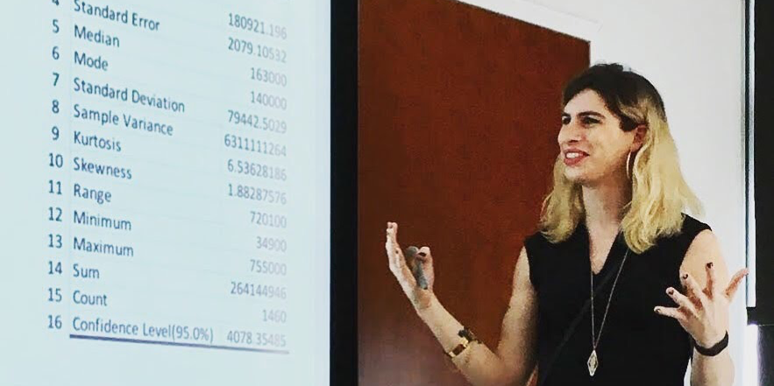


Who am I?
Sophie Searcy
Curriculum development lead and Data Science Instructor at Metis
Deep Learning and Data Science Ethics
Write and lead free workshops with t4tech

Slide 4
Signposting

Slide 5
Who is this for
Someone who
Understands and can explain the fundamentals of modern Deep Learning (there will be a review)
BackProp
Stochastic Gradient Descent
Common loss and activation functions
Has built models using a recent Deep Learning package (PyTorch, Theano, Keras, etc.)

Slide 6
What we’ll cover
Students should be able to:
Understand and explain the important components of Generative Adversarial Networks
Use provided boilerplate code and adapt it for new purposes
State of The Art techniques in GANs:
Students will be exposed to a few important, recent developments.
Students will have the building blocks needed to independently explore new techniques.

Slide 7
Deep Learning Review

Slide 8
What makes deep Learning special?
Typical Machine Learning
Data
Transformations
Feature engineering, feature extraction
Tuned by hand, parameter search
Model
Linear model, SVM, RF, etc.
Optimized wrt objective function
Output

Slide 9
What makes deep Learning special?
Deep Learning
Data
Transformations
Deep Learning model
Optimized wrt objective function
Model
Output

Slide 10
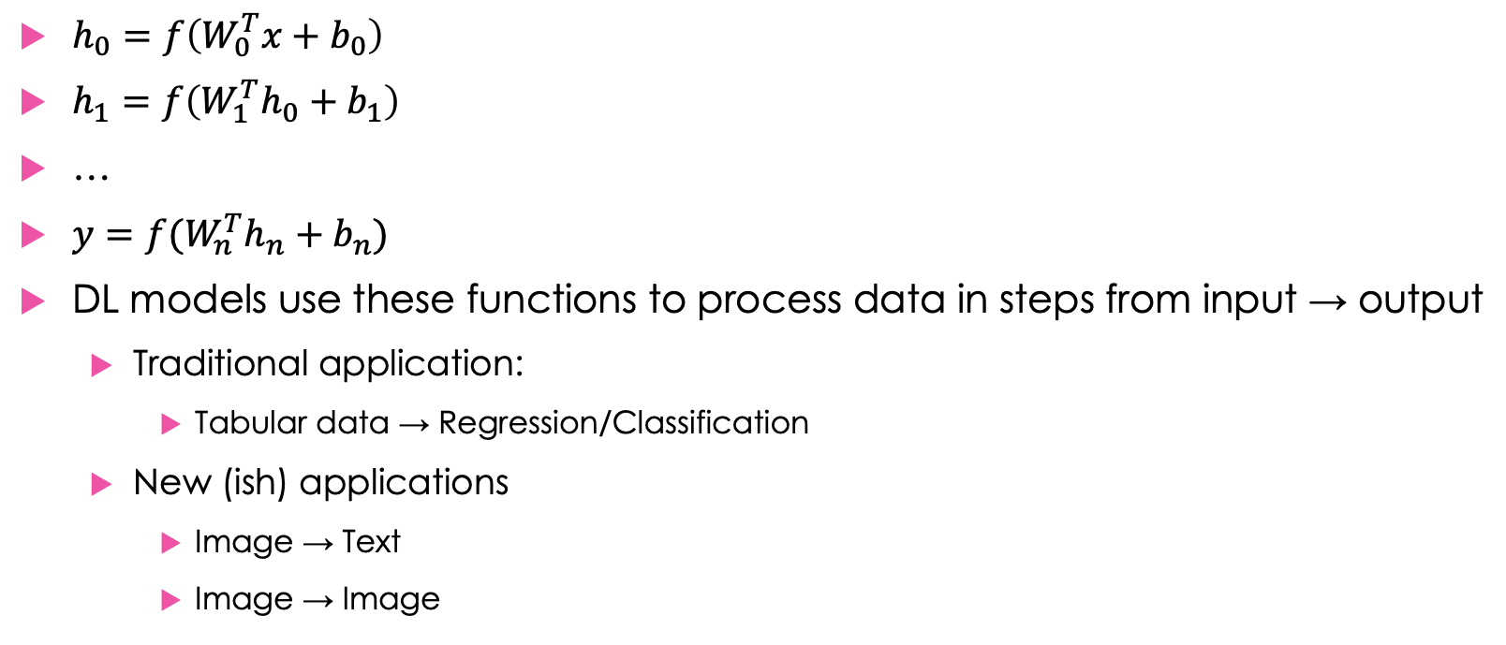
Essential parts: Differentiable functions
$h_{0}=f\left(W_{0}^{T}x+b_{0}\right)$
$h_{1}=f\left(W_{1}^{T}h_{0}+b_{1}\right)$
…
$y=f(W_{n}^{T}h_{n}+b_{n})$
DL models use these functions to process data in steps from input → output
Traditional application:
Tabular data → Regression/Classification
New (ish) applications
Image → Text
Image → Image
Notes:
Everyone here has likely been persuaded of the value of deep learning models. But we should review, why do they work so well?

Slide 11
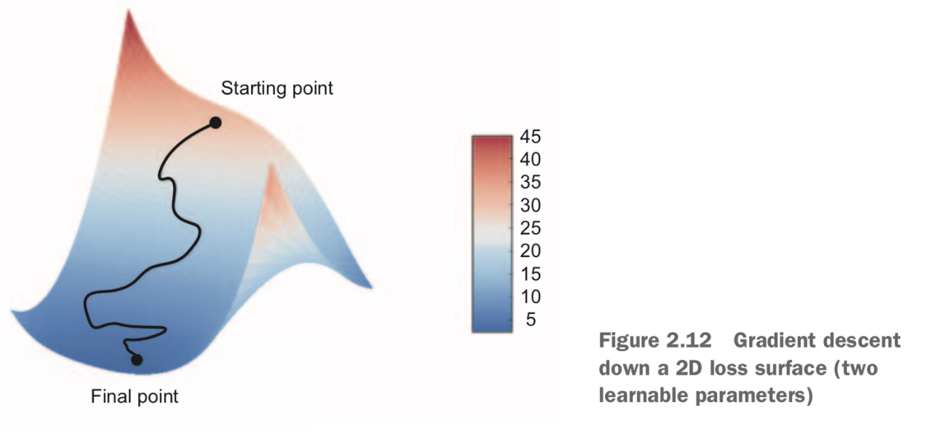
Essential parts: Stochastic Gradient Descent + BackProp
Gradient Descent
Finds adjustment to function parameters that minimizes the loss function
Back Propagation
Chain rule of calculus in algorithm form.
Applies gradient descent over many layers of a network.
Chollet 2018
Notes:
Everyone here has likely been persuaded of the value of deep learning models. But we should review, why do they work so well?

Slide 12
GAN Overview

Slide 13
Convolutional Classifiers
Convolutions learn feature maps
Use sampling/pooling to summarize over height and width of image
Output is some classification vector, e.g. probabilities
source

Slide 14
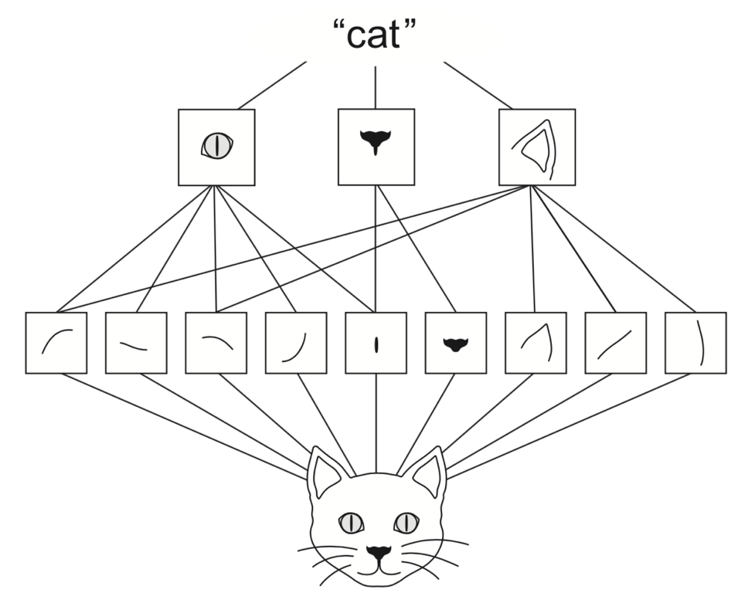
Convolutional filiters
Pixels → subparts → parts → whole
Chollet 2018

Slide 15
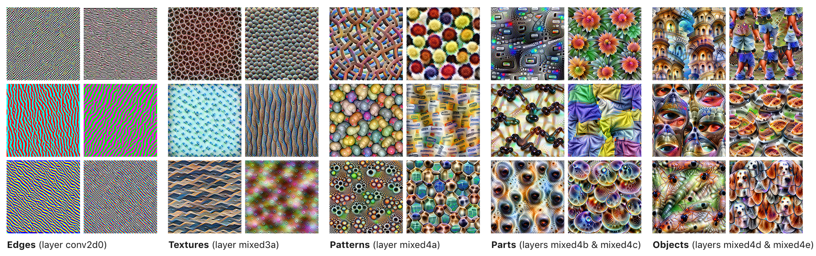
Convolutional filters
Pixels → subparts → parts → whole
We can visualize this progression by finding input that maximizes activity at layer
Olah 2017

Slide 16
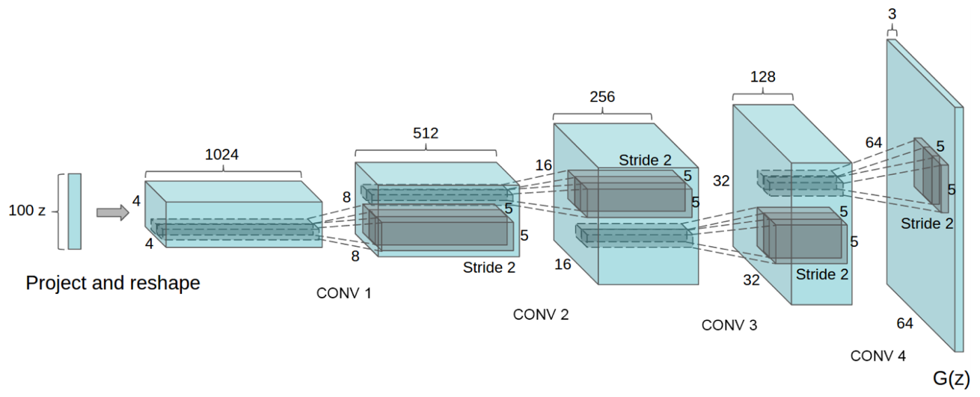
Convolutional Generation
Convolutions learn feature maps
Upsampling/DeConvolution progressively grow image
Radford et al 2015

Slide 17
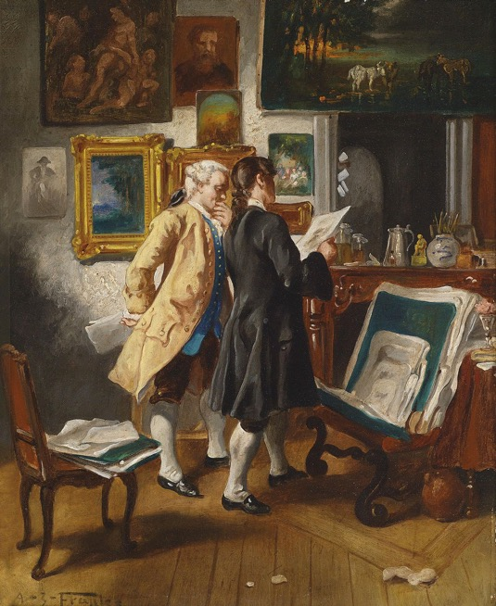
GAN Architecture
D(x) - Discriminator
Given image
Attempts to classify as fake or real

Slide 18
GAN Architecture
G(z) - Generator
Given random vector z
Attempts to generate an image that fools D(∙)

Slide 19
GAN Architecture
G(z) - Generator
Given random vector z
Attempts to generate an image that fools D(∙)
D(x) - Discriminator
Given image
Attempts to classify as fake or real

Slide 20
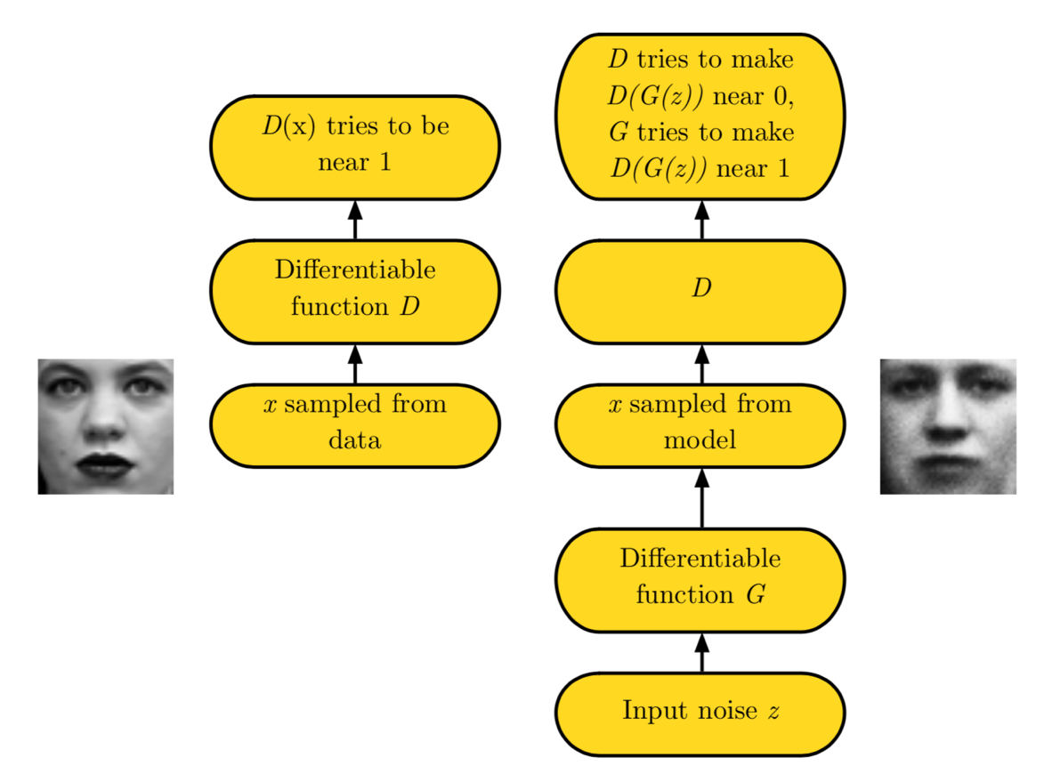
GAN Architecture
Goodfellow 2016

Slide 21
Generator task
G(z) - Generator
Given random vector z
Attempts to generate an image that fools D(∙)
Imagine you are the generator
CIFAR image data (32x32)
Generate a frog that will fool the discriminator

Slide 22
Generator task
You are the generator
Imagine you can see the training data.
You can learn as much as you want from the training data.
You have to devise a strategy to trick the Discriminator.
What is your strategy for fooling the discriminator?
i.e. what if you had to say/write pseudocode for the best strategy in a minute or so?

Slide 23
Generator task
What is your strategy?
Memorize training images?
You have ~ 1 million parameters but the training data has ~ 100 million pixels

Slide 24
Generator task
What is your strategy?
Memorize training images?
You have ~ 1 million parameters but the training data has ~ 100 million pixels
Instead the generator learns the distribution of the training data.
Attempts to generate an example from that distribution

Slide 25
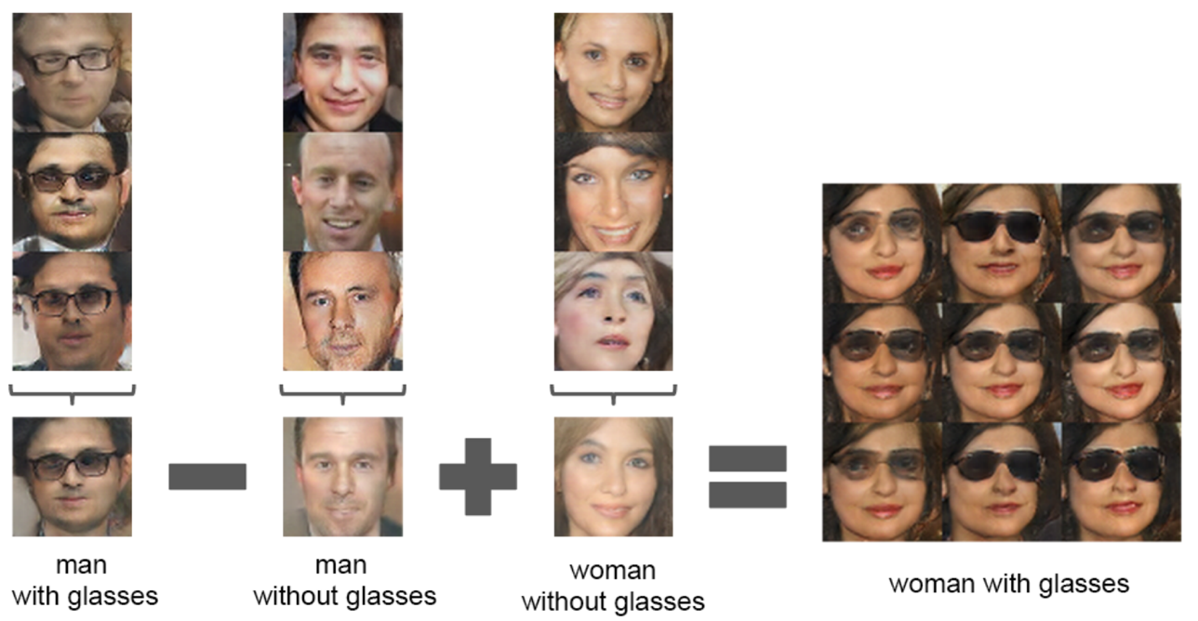
Distribution Learning
Generator learns distribution of training data
Meaningful understanding of that training data
Radford et al 2015

Slide 26
Advanced GAN Topics

Slide 27
Lipschitz Continuity
Problem: in many cases, the discriminator can be essentially impossible for the generator to beat.
Impossible to win → zero gradient → no learning
Lipschitz constant: Maximum rate of change of a function
Spectral Normalization (Miyato et al 2018) constrains the Lipshitz constant of the discriminator, ensuring stable training of generator.
source

Slide 28
Multilabel Conditional GAN

Slide 29
Classifier + GAN
Classes provide additional signal
both generator and discriminator learn data distribution more quickly
Significantly quicker learning (wall clock)
Allows direct manipulation of class feature in generator

Slide 30
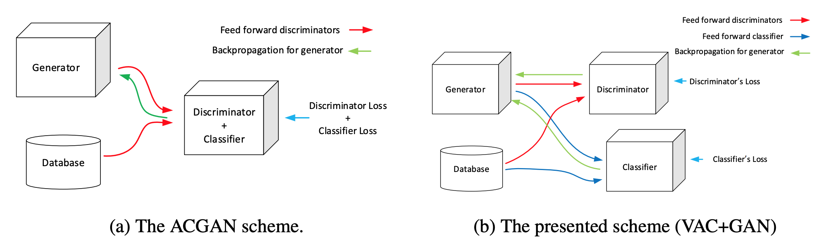
VAC GAN
Bazrafkan 2018

Slide 31
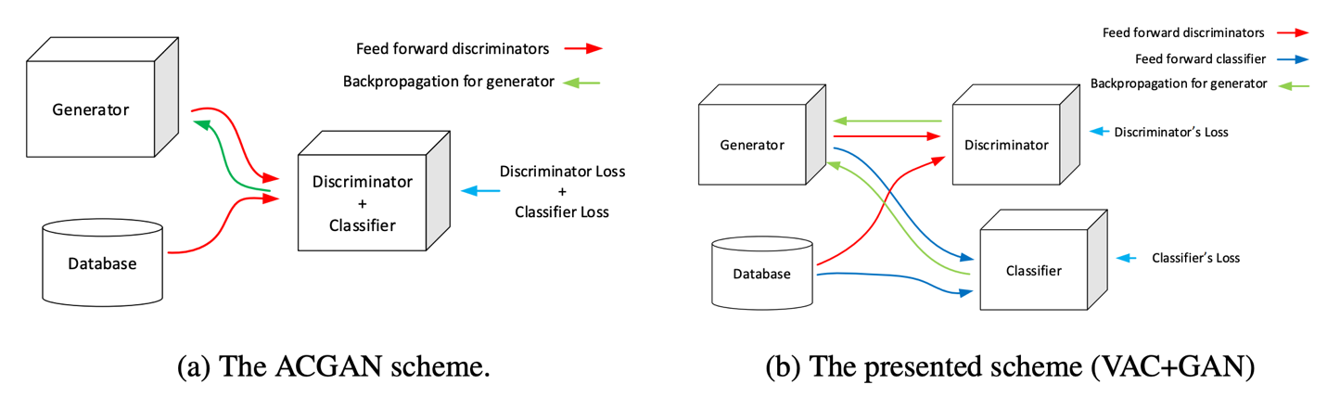
VAC GAN
VAC GAN
Good: Versatile classification with GAN
Bad: Requires a 3rd model
Today’s demo: VAC-GAN variant that combines Discriminator and Classifier
Bazrafkan 2018

Slide 32
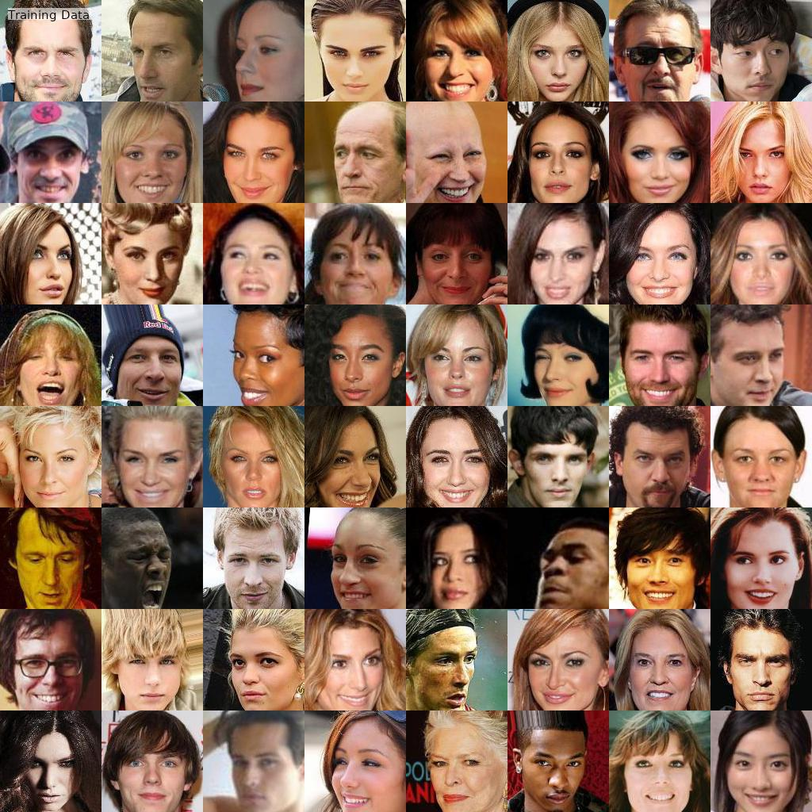
Results

Slide 33
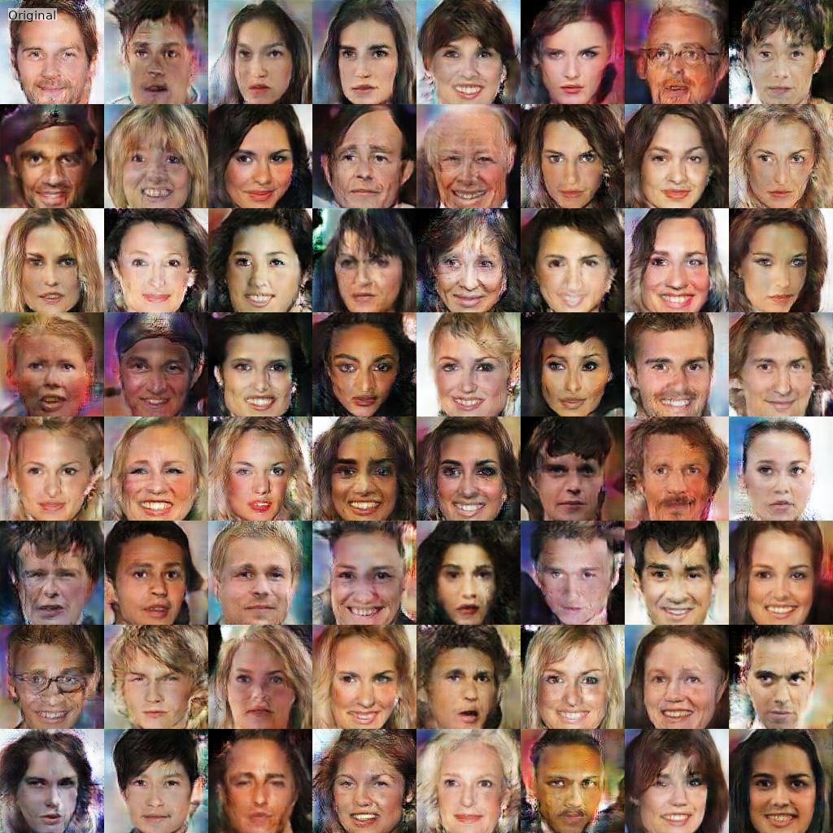
Results
Notes:
These results were generated on Google Colab (for free). You can, of course, get much better results with expensive hardware, but this is a good demo of how far you can go for free.

Slide 34

Results

Slide 35
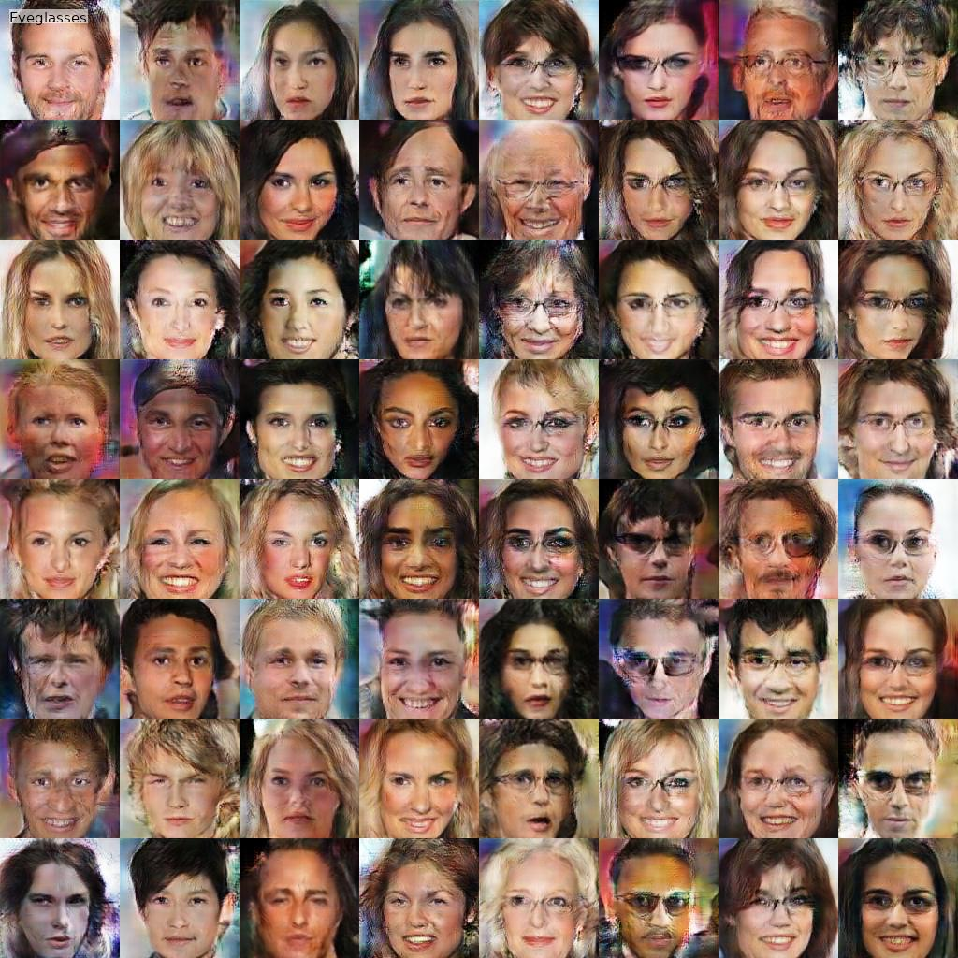
Results

Slide 36
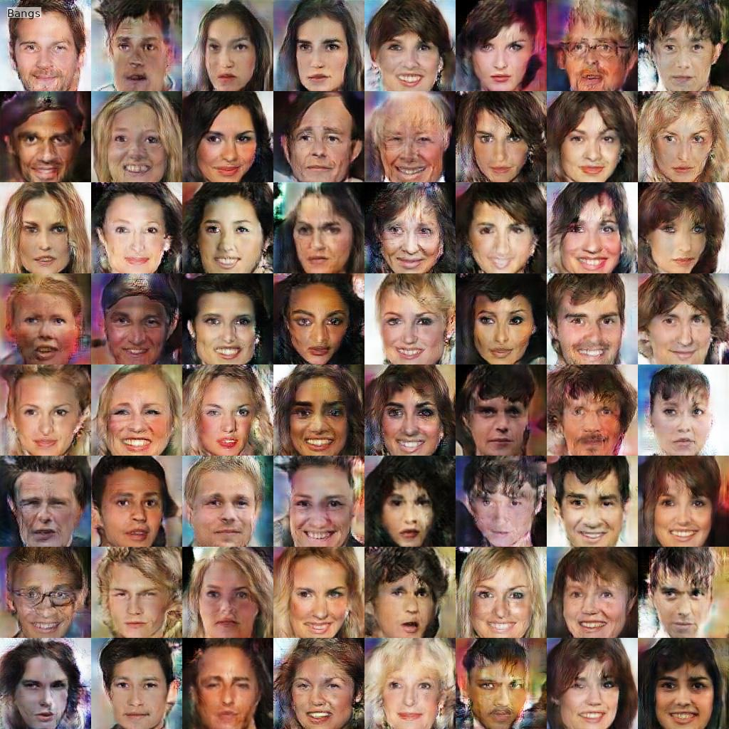
Results

